Slide 1

HEALTHCARE TREATMENT RECOMMENDATION
An Expert System using First-Order Logic and IDP
Prepared by: Fabio Dollaku, Bacem EtteiB, Yehor smyrnov
Course: Intelligent Systems – Agents and Reasoning
University of Luxembourg
December 2025

Slide 2
Problem Statement
We need to decide which treatments a patient should receive.
Multiple constraints must be satisfied:
  Every disease must be treated
  Allergies must be respected
  Drug incompatibilities must be avoided
  Age and risk factors matter
Traditional programming: hard to maintain and explain
Solution: use Logic-Based Expert System

Slide 3
Our Approach – Domain and Vocabulary
What do we model?
Types:
  Patient, Disease, Symptom, Treatment
Key Predicates:
  HasDisease(p, d) – which patient has which disease
  Treats(t, d) – which treatment works for which disease
  Allergic(p, t) – patient allergies
  Incompatible(t1, t2) – drug interactions
  HighRisk(p), Age(p) – patient properties
Output:
  Recommended(p, t) – the decision: which treatment for which patient

Slide 4
Core Constraints (FOL)
Basic Rules We Enforce:
  Every disease is treated
    ∀p ∀d (HasDisease(p, d) → ∃t (Treats(t, d) ∧ Recommended(p, t)))
  No incompatible pairs
    ∀p ∀t1 ∀t2 (Recommended(p, t1) ∧ Incompatible(t1, t2) → ¬Recommended(p, t2))
  Respect allergies
    ∀p ∀t (Recommended(p, t) → ¬Contraindicated(p, t))

Slide 5
Extended Constraints
Making the System More Realistic:
  High-risk patients: treatments must address their symptoms
  Elderly (>75): no ibuprofen
  Elderly (>70): at most 2 treatments
  Hypertension: must get amlodipine
  Asthma or pneumonia: must get bronchodilator
  Antibiotic stewardship: low-risk flu → no antibiotics
Total: 16 constraints (10 base + 6 extensions)

Slide 6
IDP Implementation
How We Built It:
  Define vocabulary with types and predicates (IDP syntax)
  Create structure with example patients and facts
  Write theory with definitions and constraints
  Run allmodels(T, S) to find all valid treatment plans
Example patients:
  Alice (35, flu) → paracetamol
  Bob (72, pneumonia) → antibiotics + bronchodilator
  Charlie (28, asthma) → bronchodilator
  Diana (80, high-risk, hypertension + flu) → amlodipine + targeted treatments

Slide 7
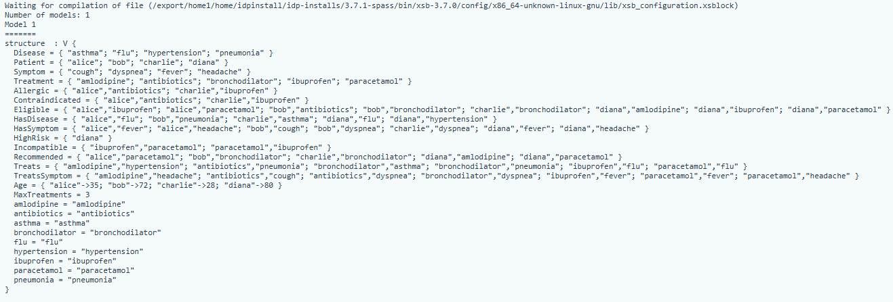
Results and Interpretation
IDP found exactly one valid model – all our constraints are consistent and there is a unique optimal treatment plan.
The Recommended predicate shows which treatments each patient receives:
  Alice: paracetamol
  Bob: bronchodilator
  Charlie: bronchodilator
  Diana: amlodipine, paracetamol
All decisions are explainable by the FOL rules.
Alice (35, flu) | Bob (72, pneumonia) | Charlie (28, asthma) | Diana (high-risk, elderly)
✓ Gets paracetamol (treats flu and fever) | ✓ Gets bronchodilator (treats pneumonia and dyspnea) | ✓ Gets bronchodilator (treats asthma, required by constraint 12) | ✓ Gets amlodipine (for hypertension – required) ✓ Gets paracetamol (treats flu and fever)
✗ Does not get ibuprofen (would violate incompatibility with paracetamol) | ✗ Does not get antibiotics (selective antibiotic use policy for low-risk patients) |  | ✗ No ibuprofen (elderly > 75) ✗ No unnecessary antibiotics (targeted use policy)

Slide 8
Conclusion
What We Learned:
✓ Natural language rules can be precisely formalized in FOL
✓ IDP can automatically reason about complex constraints
✓ Logic-based systems are transparent and maintainable
✓ If medical guidelines change, we just update the constraints
Next Steps:
  Add more diseases/treatments (scalable approach)
  Incorporate patient preferences or cost constraints
  Deploy as part of clinical decision support

Slide 9


Thank you!

